Slide 1

GROUP 3: SYSTEM UNIT AND ITS
COMPONENTS
Group Members
Name | Matric No
ARULMURUGAN A/L SUBRAMANIYAM | SX210291ECJHS01
CHE KU MARDIAH BINTI CHE KU MAHHADI | SX241899ECJHF01
LEE MING DA (NICHOLAS) | SX240634ECRHS01
LOUIS PAUL A/L KUALIANTAISAMI | SX240262ECRHS01

Slide 2
Definition of System Unit
Often referred to as the computer case or chassis
Is the main enclosure that houses the essential components of a computer.
Serves as the framework for the internal hardware.
Providing protection and organization.
Connectivity for the various components that make up a computer systems.
Typically include the motherboard, CPU, RAM, power supply, storage devices, and expansion cards.

Slide 3
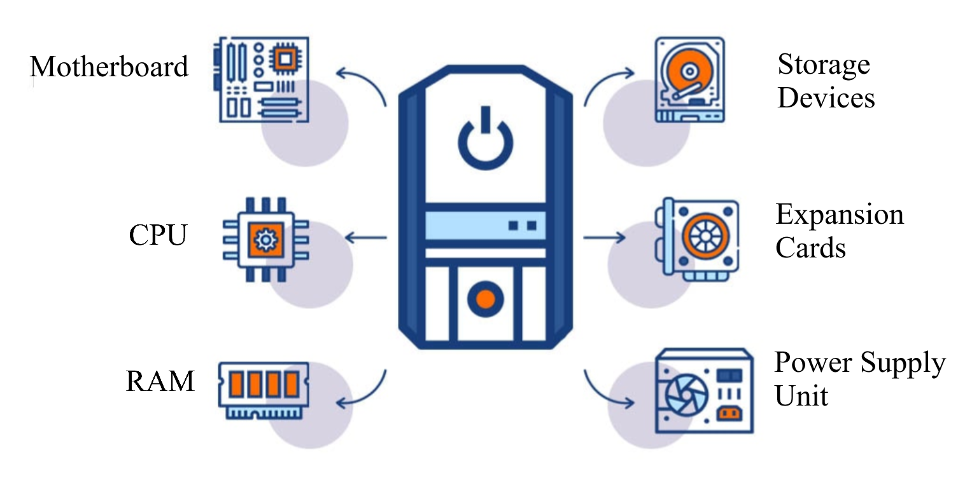
Major Internal Components

Slide 4
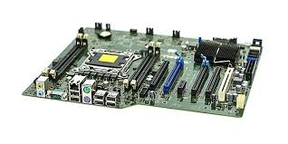
Motherboard
The main circuit board that connects all the other components.
It contains connectors for the CPU, RAM, storage devices, and expansion cards.
It also includes ports for connecting peripherals like keyboards, mice, and monitors.

Slide 5
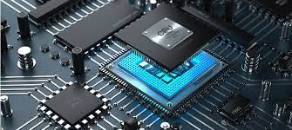
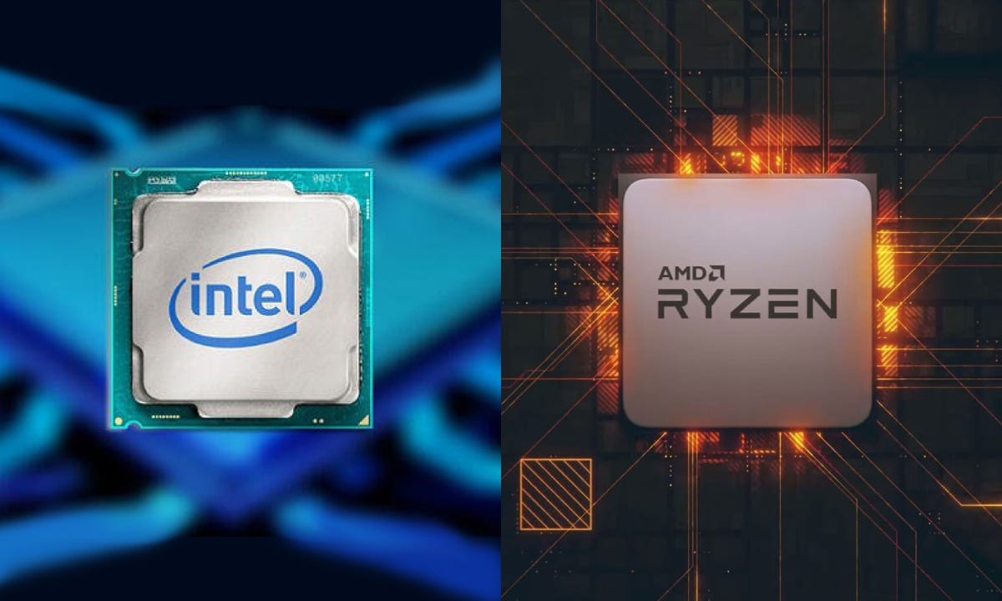
CPU (Central Processing Unit)
The "brain" of the computer, responsible for executing instructions and performing calculations.
CPU will be mounted on the motherboard and often has a cooling system (heat sink and fan) to dissipate heat.

Slide 6
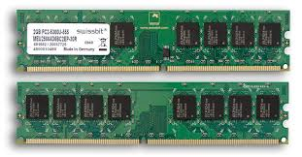
RAM (Random Access Memory)
Temporary storage for data and instructions that the CPU is currently using.
It's volatile, meaning data is lost when the power is turned off.
RAM is connected to the motherboard and provides fast access to the CPU.

Slide 7
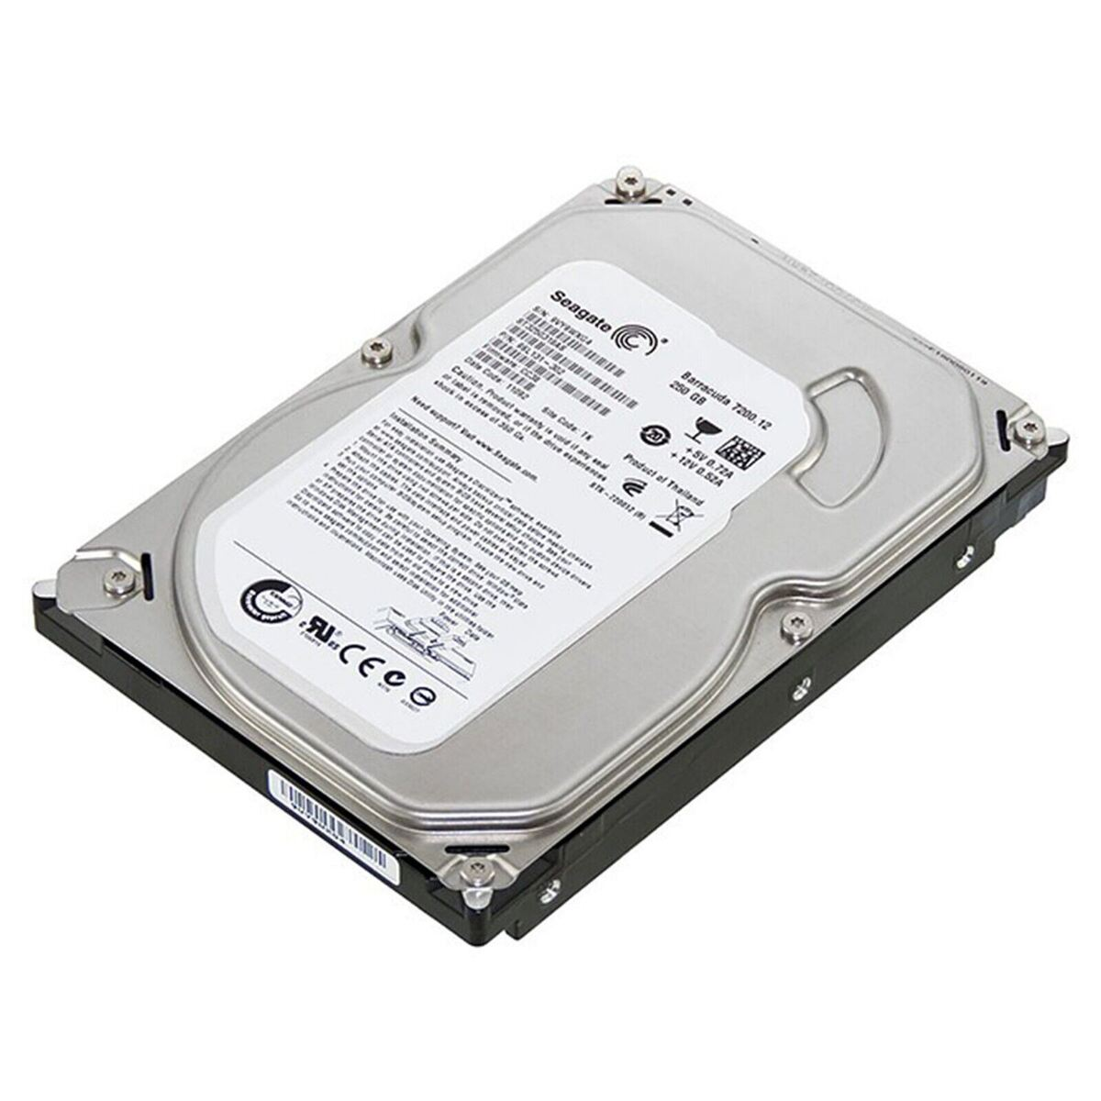
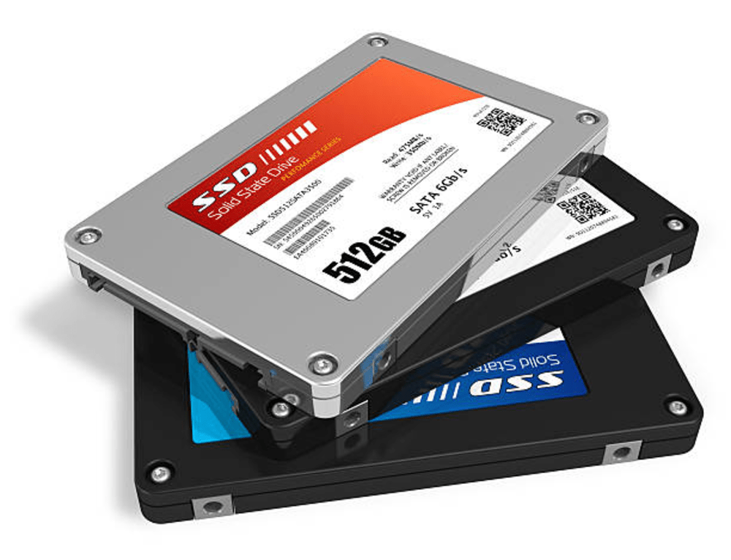
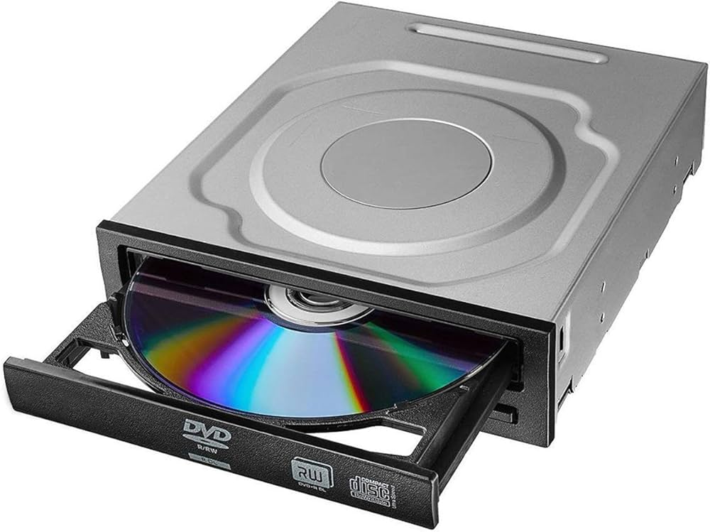
Storage Devices
Hard Disk Drive (HDD) or Solid State Drive (SSD): Permanent storage for the operating system, applications, and user data.
Optical Drives (CD/DVD/Blu-ray): Used for reading and writing data on optical discs.

Slide 8
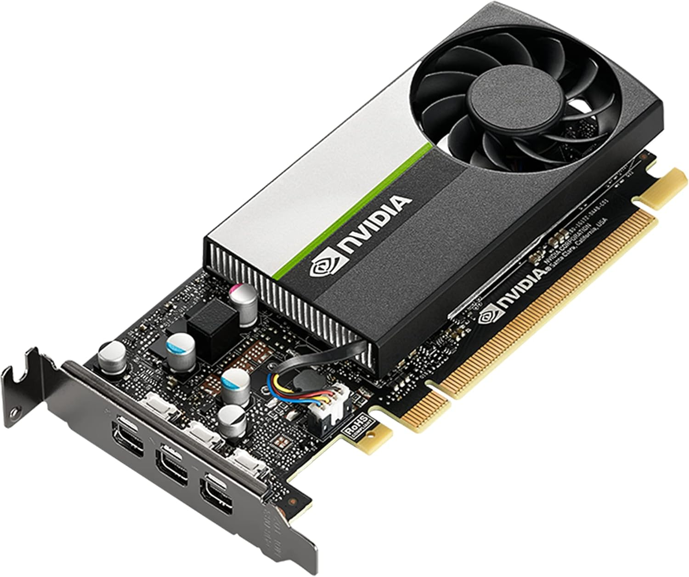
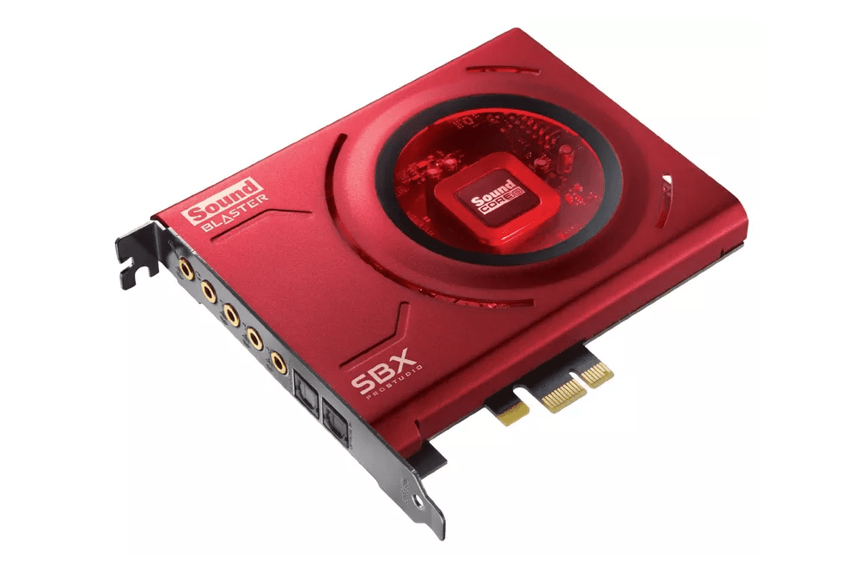
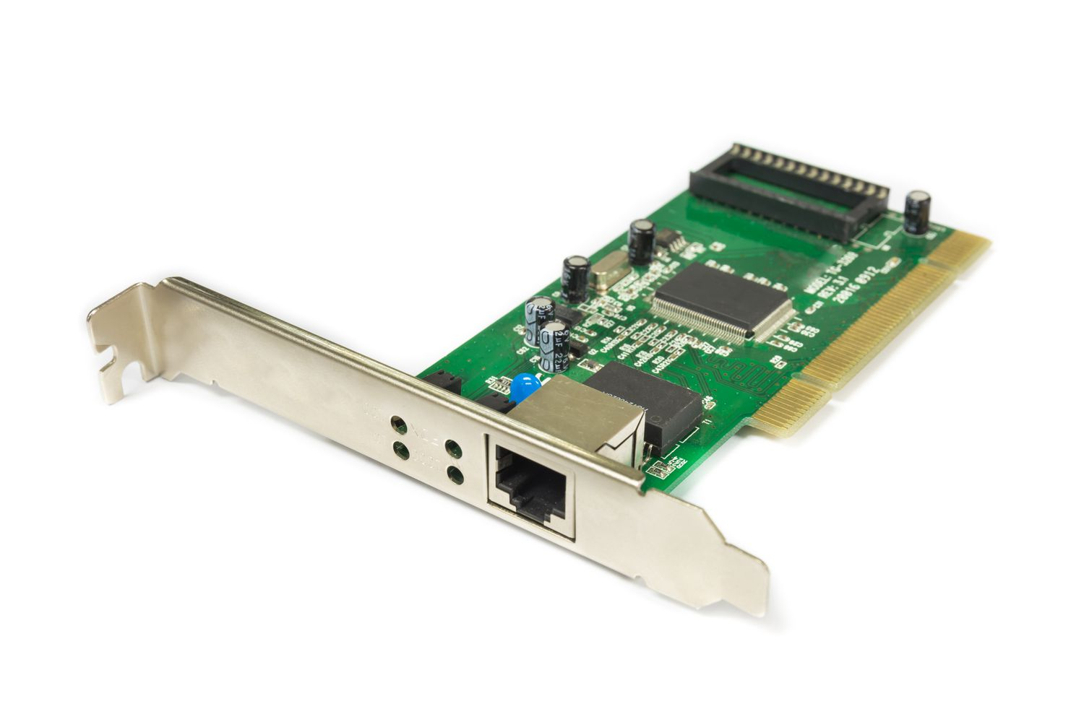
Expansion Cards
Additional cards that can be inserted into the motherboard to add functionality, such as graphics cards, sound cards, and network cards.

Slide 9
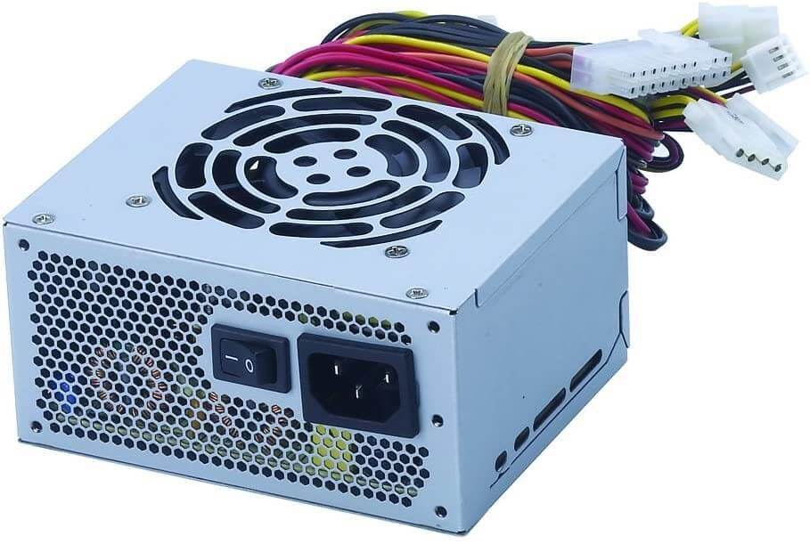
Power Supply Unit (PSU)
Provides power to all the components within the system unit.
It converts AC power from the wall outlet to DC power that the computer can use.

Slide 10
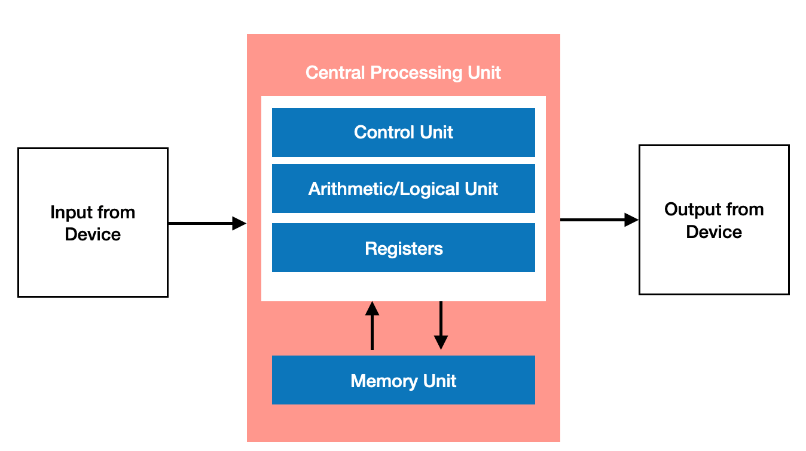
Description of CPU
The core components of a CPU are the Control Unit (CU), Arithmetic Logic Unit (ALU), and Registers.

Slide 11
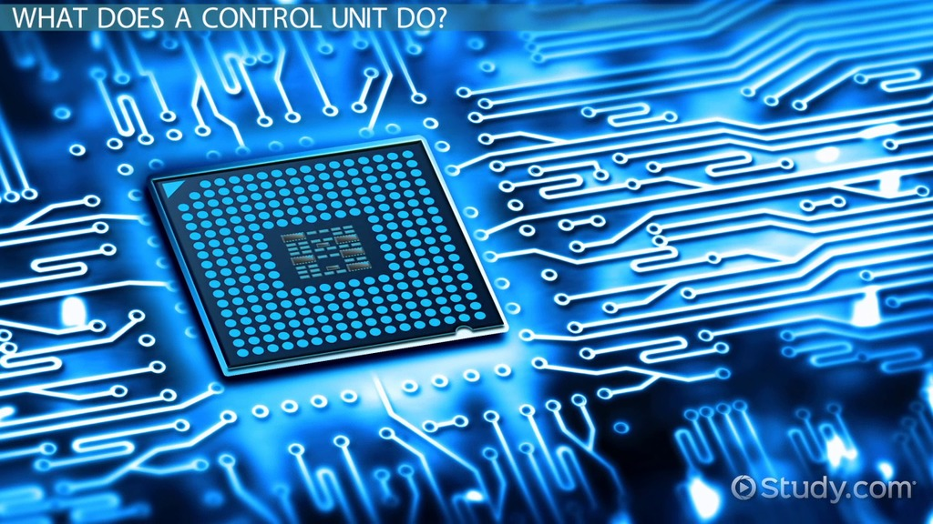
Control Unit (CU)
The part of the CPU that directs the operation of the processor.
It tells the computer's memory, ALU, and input/output devices how to respond to the instructions that have been sent to the processor.

Slide 12
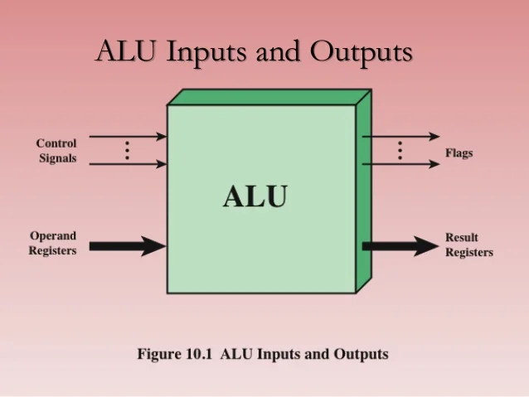
Arithmetic Logic Unit (ALU)
The component of the CPU that performs arithmetic and logical operations.
It handles all mathematical calculations and logical comparisons.

Slide 13
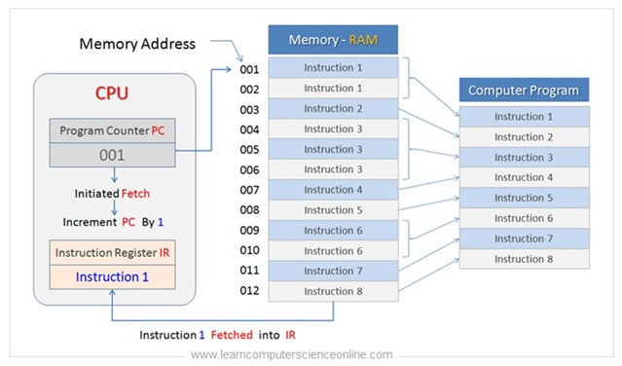
Registers
Small, high-speed storage locations within the CPU that temporarily hold data and instructions.
Registers are used to store intermediate results of calculations and to hold the addresses of memory locations.

Slide 14
Functions and Importance of Each Components
Mother Board
Functions | Acts as the backbone of the computer, allowing communication between all components.
Importance | It is crucial for system stability and performance.
CPU
Functions | Executes instructions and processes data, making it the most critical component for overall system performance.
Importance | A faster CPU can significantly enhance computing speed.

Slide 15
Functions and Importance of Each Components
RAM
Functions | Provides temporary storage for data that the CPU needs to access quickly.
Importance | More RAM allows for better multitasking and smoother performance in applications.
Storage Devices
Functions | Store the operating system, applications, and user data.
Importance | The speed and capacity of storage devices affect system boot time and application load times.

Slide 16
Functions and Importance of Each Components
Expansion Cards
Functions | Allowing for customization based on user needs, such as improved graphics, network or sound capabilities.
Importance | Expansion cards are crucial for enhancing a computer system's functionality and capabilities.
Storage Devices
Functions | Ensures that all components receive the correct voltage and current.
Importance | A reliable power supply is essential for system stability and longevity.

Slide 17
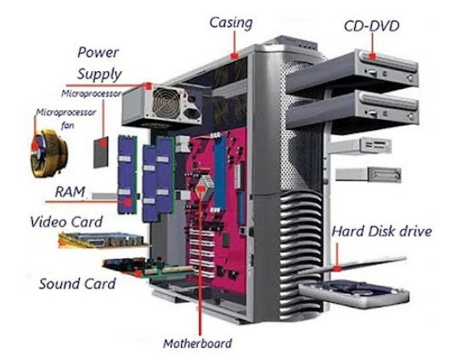
Visual Breakdown of a System Unit

Slide 18
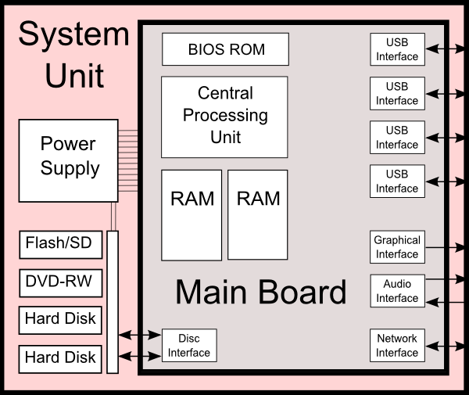
Diagram of a System Unit

Slide 19
Quiz Time !!!
List three internal components of system unit.
What is the role of the control unit in the CPU?

Slide 20


